Slide 1


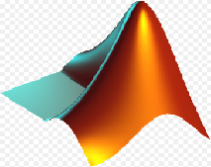
Automatic Class Attendance System Based On Face Detection And Recognition
Aryan - 20BCS3912
Karan - 20BCS3928
Siddharth - 20BCS3933
Sonu Saurav - 20BCS3952
Sushant Bisht - 20BCS6148
Supervisor:
Sukhman Mam

Slide 2
Outline :
1. Introduction
2. Problem Statement
3. Objective
4. Algorithm ( flow chart )
5. Problem we faced
6. Conclusion
7. Future Work

Slide 3


Introduction :
Traditionally attendance is marked manually by teachers and they must make sure correct attendance is marked for respective student.
This whole process wastes some of lecture time and part of correct information is missed due to fraudulent and proxy cases.

Slide 4
Problem Statement:
Attendance is an important part of daily classroom evaluation. At the beginning and ending of class, it is usually checked by the teacher, but it may appear that a teacher may miss someone or some students answer multiple times. Face recognition-based attendance system is a problem of recognizing face for taking attendance by using face recognition technology based on high definition monitor video and other information technology.
Face Detection
Where the input image is searched to find any face
Face Recognition
Where the detected face is compared to the database of known faces

Slide 5
OBJECTIVE :
Face recognition is considered the step toward building biometric access control based application scenarios where biometric features are extracted from individual. Using facial-recognition system our main objective is to mark attendance of individual and store its details in excel sheet. It is an automated system which mark attendance of the user automatically, efficiently whose image is stored in the database.

Slide 6




Significance:
1-Automated
2- Economically
3-Effective
4- Keep extra time

Slide 7
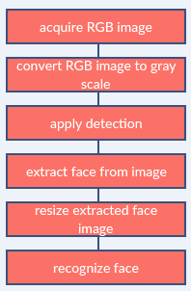
Image processing:

Slide 8
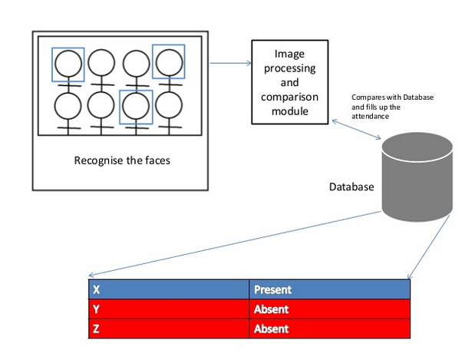

Slide 9
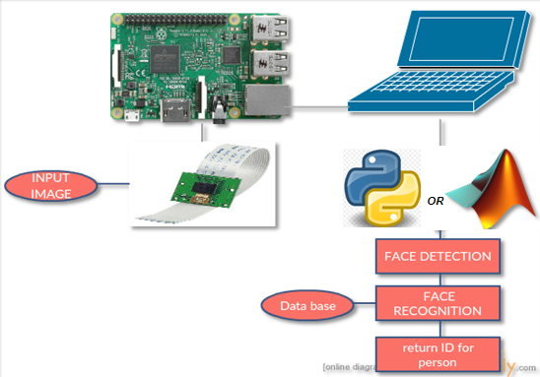
Functional Block Diagram:
The whole system should consist of

Slide 10
Face Detection:
Face detection is a computer technology used to identify human faces in digital images by determining the location of the faces in the image and extract sub images for each face.
Viola Jones algorithm will be implemented to recognize face and non-face patterns and enable us to identify locations of the faces in the image.

Slide 11
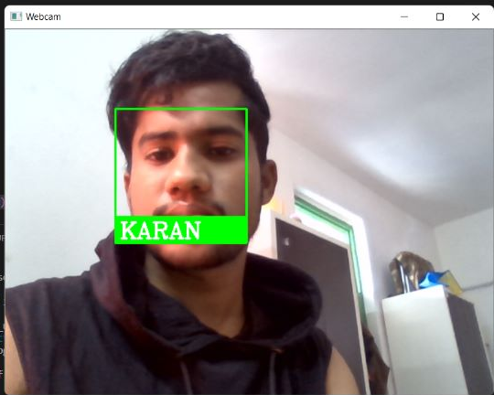
Example for detect face :

Slide 12
How Do We Create Database
Database is the collection of face images and extracted features. And the database includes names of students & registertion number for each student .
We created a data base for 9 persons, were we took 3 images per person using webcam, these images were taken at different times and with variations in illumination, facial expressions, and facial details.

Slide 13
EigenFace for Recognition face
1. Create a training set and concatenate columned images into one matrix.
2. Normalize the images and calculate the covariance matrix.
3. Calculate the eigenvalue and the weights for all images.
4. Input an unknown face image.
5. Normalize and calculate weights for input image.
6. Calculate the distance.

Slide 14
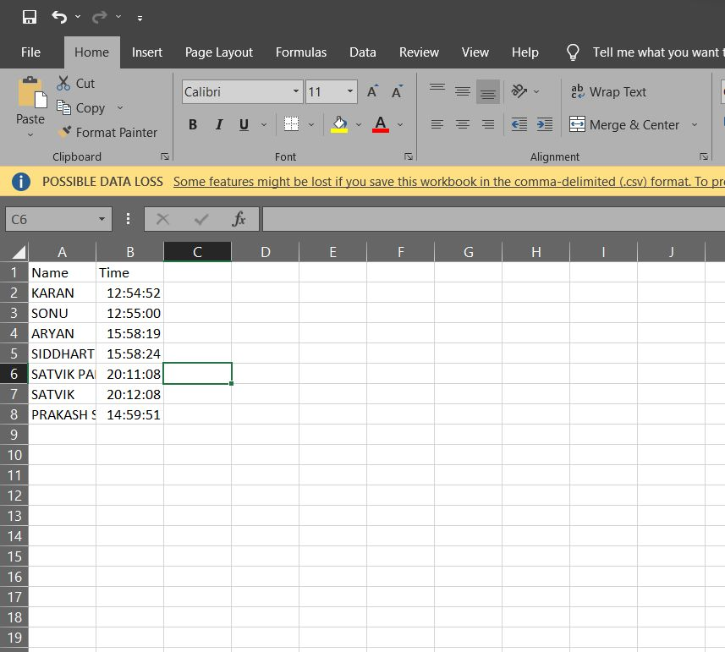
Then the code will creates a text file for present students as shown:

Slide 15
The problem that we faced
In our project we have faced many of problems and we have overcome them:
1- Download Python and library from a third party.
2- Version of the python.

Slide 16
Conclusion:
From our experiment, we noticed the face recognition was sensitive to face background, light, and head orientations. This technique described the accurate and efficient method of automatic attendance in the classroom which could replace the traditional method. An automatic attendance has many advantages, most of the existing systems are time consuming and require semi manual interference from lecturers, our system seeks to solve these issues by using face recognition in the process to save the time and labor. And No need for installing complex hardware for taking the attendance in classroom, all we need is a camera and laptop. We used algorithms that can detect and recognize faces in the image.

Slide 17
Future work
Automatic attendance system can be improved by increasing the number of features which can be extracted to increase accuracy of face recognition. Once the software is developed and tested properly, it could be improved to cover full institutions such as the faculty of engineering.

Slide 18


